Slide 1
DirectX Library & Graphics

Slide 2
What is DirectX
DOS4GW or some other 32-bit DOS extender
DOS had allowed them to program as "close to the metal" as possible
A generic API would have made games too slow in Windows 95
Software Development Kit (SDK) called DirectX

Slide 3
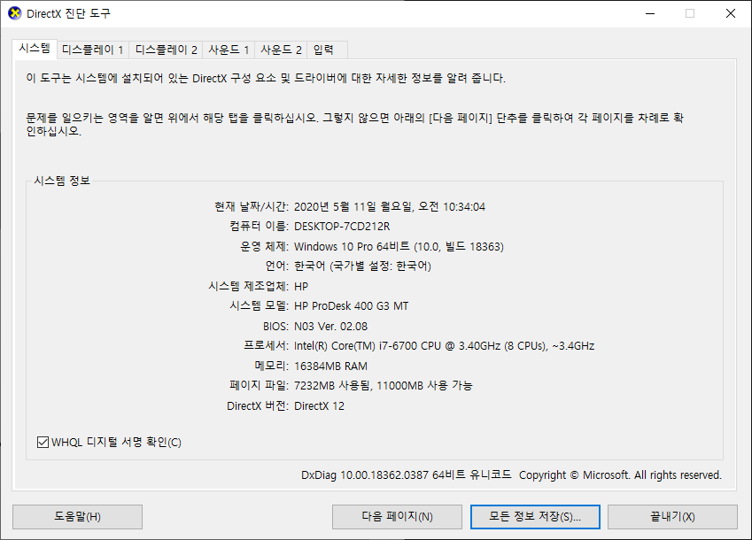
What is DirectX
Built directly into the Windows OS
A set of APIs
access 3-D graphics accelerators and sound cards
low-level functions
graphics memory management
rendering
support for input devices
sound mixing and sound output

Slide 4
DirectX Components
DirectDraw : 2 dimensional graphics capabilities, surfaces, double buffering
Direct3D : A extensively functional 3D graphics programming API.
DirectSound : Sound, 3D sound
DirectPlay : Network game development
DirectInput : Handles input from various peripherals

Slide 5
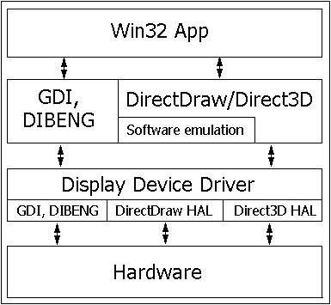
DirectX performance and hardware acceleration
DirectDraw and Direct3D’s layer
thin layer above H/W
hardware abstraction layer (HAL).
hardware emulation layer (HEL).

Slide 6
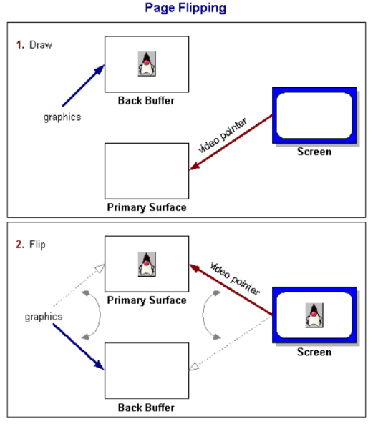
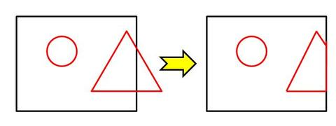
A few gaming concepts
Bitmaps and sprites
Double buffering and page flipping
“tearing”
Clipping and DirectDraw clippers
DirectDraw surfaces
to access any section of memory

Slide 7
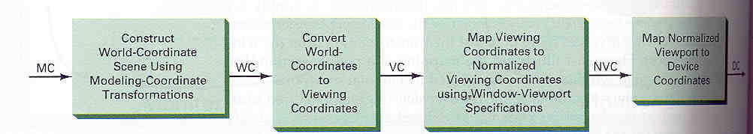
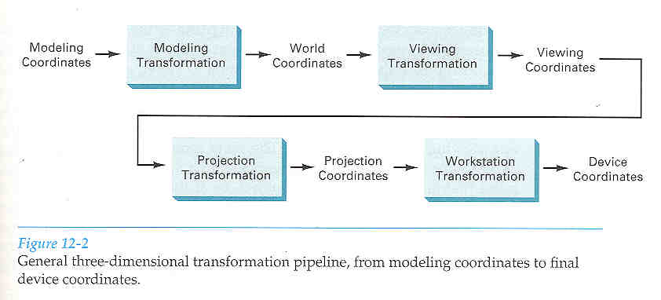
Viewing
2D Viewing pipeline
3D
Projection 3D -> 2D

Slide 8
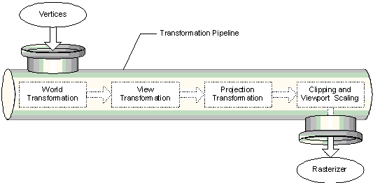
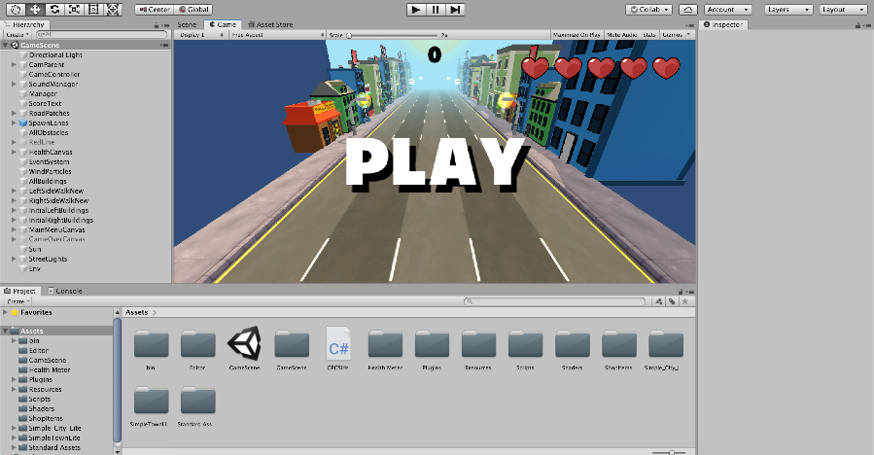
Simple Game Loop
Initialization
Rendering
User Interaction
A.I. Calculation for NPC
Scene Graph Update
Position, Score, Status, etc.

Slide 9
A Simple DirectDraw sample
Setting up DirectX under Visual C/C++
Add the directories of library and include
"library directories"
"include directories"
Add the required libraries to the project
ddraw.lib dplayx.lib dinput.lib d3dx.lib
winmm.lib

Slide 10
A Simple DirectDraw sample
General outline of sample DirectDraw
Create a normal Windows window
Set up our DirectX variables
Set the "cooperative level" and display modes
Create front and back surfaces
If windowed mode, create and attach a clipper
Render to the back buffer
Perform the flipping
Clean up

Slide 11
A Simple DirectDraw sample
LPDIRECTDRAW g_pDD;
LPDIRECTDRAWSURFACE g_pDDS;
LPDIRECTDRAWSURFACE g_pDDSBack;
LPDIRECTDRAWCLIPPER g_pClipper;
HWND g_hWnd;
bool g_bFullScreen;
HRESULT hr;
hr = DirectDrawCreate(NULL,&g_pDD,NULL );

Slide 12
Setting Screen mode
bool DDCreateSurfaces( bool bFullScreen){
HRESULT hr;
g_bFullScreen = bFullScreen;
// If we want to be in full-screen mode
if (g_bFullScreen) {
hr = g_pDD->SetCooperativeLevel(g_hWnd,
DDSCL_EXCLUSIVE | DDSCL_FULLSCREEN |
DDSCL_NOWINDOWCHANGES);
// Set 640x480x16 full-screen mode
hr = g_pDD->SetDisplayMode(640, 480, 16);
}
else{
// Set DDSCL_NORMAL to use windowed mode
hr = g_pDD->SetCooperativeLevel(g_hWnd,
DDSCL_NORMAL);
}
...

Slide 13
Creating surface
DDSURFACEDESC ddsd; // A structure to describe the surfaces we want
memset(&ddsd, 0, sizeof(ddsd));
ddsd.dwSize = sizeof(ddsd);
//-- Create the primary surface
// fields will contain valid values
ddsd.dwFlags = DDSD_CAPS;
ddsd.ddsCaps.dwCaps = DDSCAPS_PRIMARYSURFACE;
hr = g_pDD->CreateSurface(&ddsd, &g_pDDS, NULL);
//-- Create the back buffer
ddsd.dwFlags = DDSD_WIDTH | DDSD_HEIGHT | DDSD_CAPS;
// Make our off-screen surface 320x240
ddsd.dwWidth = 320;
ddsd.dwHeight = 240;
// Create an offscreen surface
ddsd.ddsCaps.dwCaps = DDSCAPS_OFFSCREENPLAIN;
hr = g_pDD->CreateSurface(&ddsd, &g_pDDSBack, NULL);
...

Slide 14
Creating the Clipper
...
//-- Create a clipper for the primary surface in windowed mode
if (!g_bFullScreen){
// Create the clipper using the DirectDraw object
hr = g_pDD->CreateClipper(0, &g_pClipper, NULL);
if (DDFailedCheck(hr, "Create clipper"))
return false;
// Assign your window's HWND to the clipper
hr = g_pClipper->SetHWnd(0, g_hWnd);
if (DDFailedCheck(hr, "Assign hWnd to clipper"))
return false;
// Attach the clipper to the primary surface
hr = g_pDDS->SetClipper(g_pClipper);
if (DDFailedCheck(hr, "Set clipper"))
return false;
}
...

Slide 15
The rendering loop
while (g_bRunning)
{
while (PeekMessage(&Msg,g_hwndMain,0, 0,PM_NOREMOVE))
{
BOOL bGetResult = GetMessage(&Msg, NULL, 0, 0);
TranslateMessage(&Msg);
DispatchMessage(&Msg);
if (bGetResult==0)
g_bRunning = false;
}
if (g_bRunning)
{
MainLoop();
}
}

Slide 16
The MainLoop function
void MainLoop()
{
// Clear the back buffer
DDClear( g_pDDSBack, 0, 0, 320, 240 );
static int iFoo = 0;
// Draw a color square
for ( int r=0; r<320; r++ ){
for ( int g=0; g<240; g++ ){
DDPutPixel( g_pDDSBack, g, r, (r*2+iFoo)%256,
(g+iFoo)%256, (320-g)*4 );
}
}
iFoo++;
// Blit the back buffer to the front buffer
DDFlip();
}

Slide 17
Flipping surfaces
void DDFlip()
{
HRESULT hr;
if (!g_bFullScreen){
RECT rcSrc, rcDest; // source blit rectangle
POINT p;
p.x = 0; p.y = 0;
::ClientToScreen(g_hWnd, &p);
::GetClientRect(g_hWnd, &rcDest);
OffsetRect(&rcDest, p.x, p.y);
SetRect(&rcSrc, 0, 0, 320, 240);
hr = g_pDDS->Blt(&rcDest, g_pDDSBack, &rcSrc,
DDBLT_WAIT, NULL);
}
else
hr = g_pDDS->Flip(NULL, DDFLIP_WAIT);
}

Slide 18
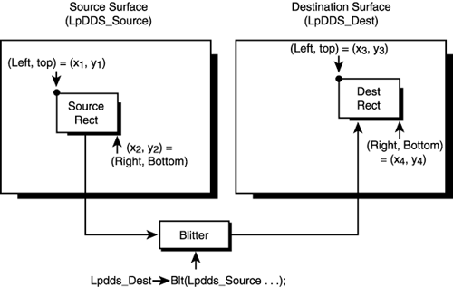
HRESULT Blt(
LPRECT lpDestRect,
LPDIRECTDRAWSURFACE lpDDSrcSurface,
LPRECT lpSrcRect,
DWORD dwFlags,
LPDDBLTFX lpDDBltFx );
HRESULT BltFast(
DWORD dwX,
DWORD dwY,
LPDIRECTDRAWSURFACE lpDDSrcSurface,
LPRECT lpSrcRect,
DWORD dwTrans );

Slide 19
DirectDraw- Exercise
Install DirectX-SDK
http://www.microsoft.com/en-us/download/confirmation.aspx?id=6812
See Example code
“NGP 101G-FlipNo” folder – ddraw.lib, winmm.lib
Check window creation, and tearing
“NGP 102G-Flip” folder
Check the difference of two applications
“NGP 103G-Blitz”
Check “LoadImage()” and Blt(), BltFast()
Modify the source to shrink and grow the sprite size
“NGP 104G-Animate” folder
Modify “blit.cpp” by “blitOrg.exe” operation with F4 button.

